Slide 1
Routine Analysis of Soils using ICP-MS and Discrete Sampling
Agilent 7850 ICP-MS provides the stability and robustness needed for the long-term accurate analysis of high matrix samples
DE44334.7416666667

Slide 2


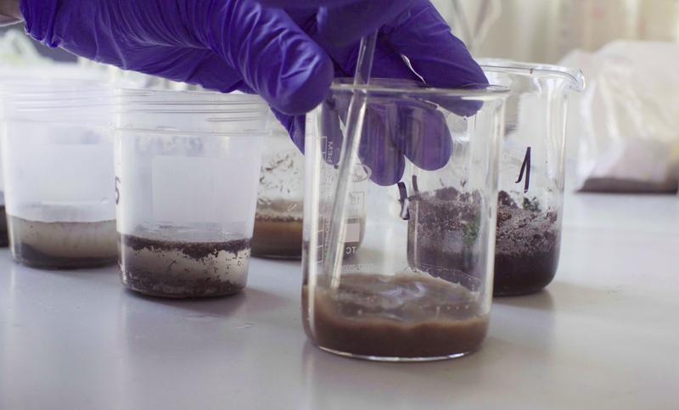
Routine Analysis of Soils – complex and high matrix samples
The Challenge
Routine monitoring of environmental samples is required to comply with regulations in many countries. But samples such as soils, sediments, and sludges can be problematic:
Complex and high matrices (high % of total dissolved solids)
Concentrations of some elements are high (often % level)
Analytes must be measured accurately from low (trace elements) to high concentration (major elements)
The Solution
Analysis requires ICP-MS with good matrix tolerance, effective control of matrix-based interferences, and wide dynamic range.
High matrix sample measurements have a potential for signal instability due to matrix deposition, and frequent maintenance requirements.

Slide 3

Environmental Testing Laboratories Face…
Challenge of managing many samples
Development of new methods to meet evolving regulations
Ensuring data quality
Maintaining a high level of productivity and data quality is vital to the success of many labs.
So, labs can benefit from reducing the time required for key steps in the workflow:
Preparing calibration standards and samples
Developing methods
Performing daily checks
Reviewing data
Reporting results

Slide 4
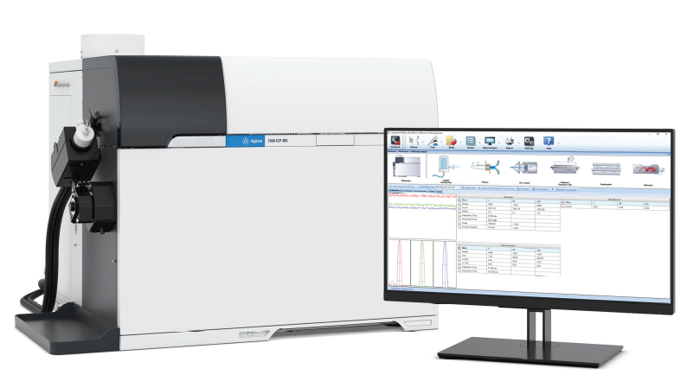
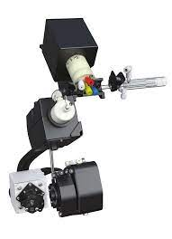
Benefits of the Agilent 7850 ICP-MS hardware
Easy to setup and use
    Method Wizard, Preset Methods and Autotune, M²⁺ correction
Effective ORS⁴ helium collision mode
    Effective removal of common polyatomic ion interferences
10 orders dynamic range
    Enables the measurement of major and trace elements in the same run
Robust, matrix tolerant plasma (low CeO⁺/Ce⁺)
    Gives consistent results in a wide range of different sample types
Benefits of the ISIS 3 discrete sampling system
High sample throughput
    Shortens time for sample introduction and rinse
Minimizing carry over from previous samples
    Sample is delivered to the plasma only during the actual data acquisition step

Slide 5
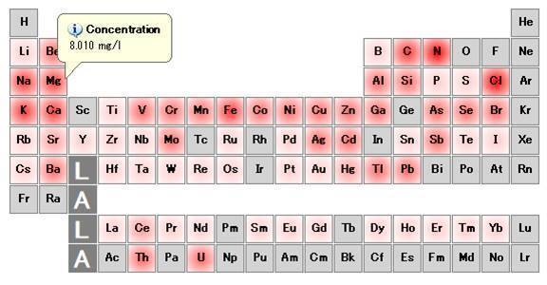
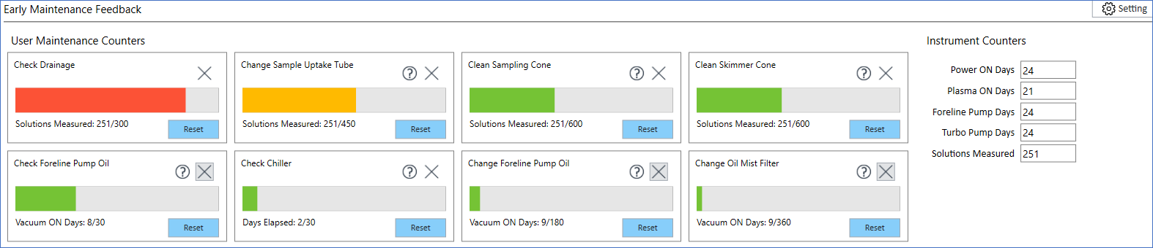
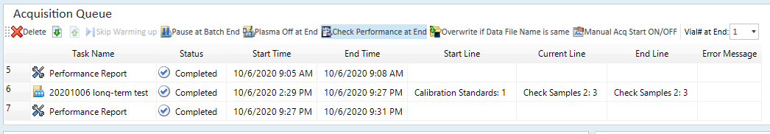
Benefits of ICP-MS MassHunter Software
Heat map
Easy to setup and use
    Method Wizard, Preset Methods and Autotune, M²⁺ correction
IntelliQuant
    Total Matrix Solid (TMS) info, Heat map display of data in periodic table view
Automatic maintenance alerts
    Early Maintenance Feedbacks (EMF), Post-run check
EMF
This unique combination of hardware performance and software functionality is one of the reasons that hundreds of laboratories worldwide use Agilent ICP-MS.
Post-run TuneCheck

Slide 6
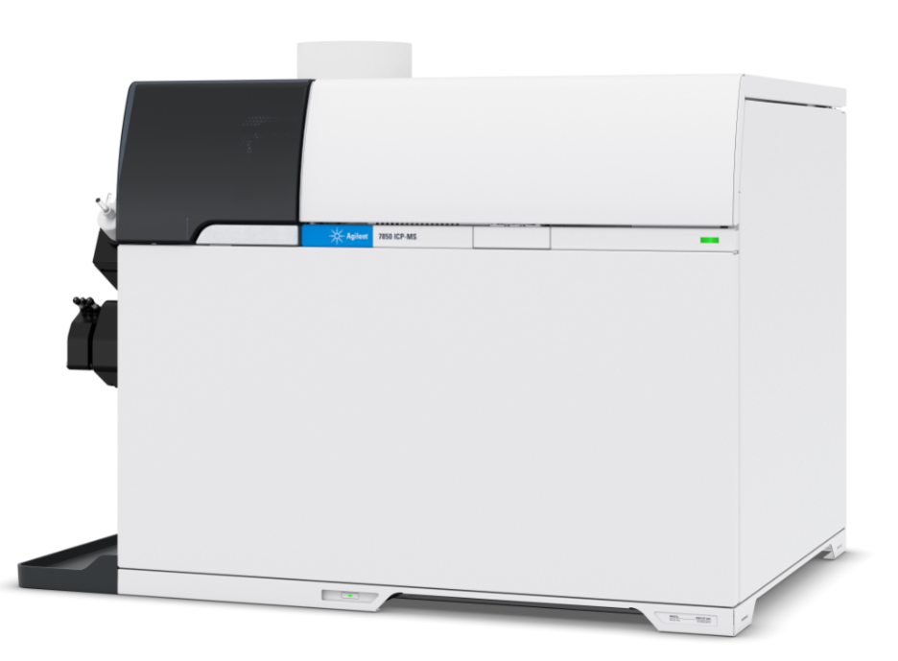
Experimental
Instrument
  Agilent 7850 ICP-MS
  ISIS 3 discrete sampling system
  SPS 4 autosampler
Plasma mode
  UHMI-8
Lens voltage
  Autotune
Cell mode
  Helium *
ICP-MS Parameter | He mode
Plasma mode | UHMI-8
RF power (W) | 1600
Spray chamber temp (°Ｃ) | 2
Sampling Depth (mm) | 10
Nebulizer gas flow (L/min) | 0.69
Dilution gas flow (L/min) | 0.28
Lens tune | Autotune
He flow (mL/min) | 1.0 | 5.0 (*10)
Energy discrimination (V) | 5.0 (*7.0)
Number of elements | 1 analyte, 1 ISTD | 27 analyte, 3 ISTD
  *Enhanced He mode settings used for Se and P. As and Se were measured at the increased resolution settings used for M²⁺ Correction

Slide 7
ISIS Parameters
ISIS 3 parameter | Setting
Loop Volume (mL) | 1.4
 | Time (sec) | Pump Speed (%)
Sample load | 9 | 35
Stabilize | 23 | 5
Probe Rinse | 25 | 8
Probe Rinse 2 | 10 | 60
Probe Rinse 3 | 10 | 5
Optional Loop Probe Wash | 13 | 60
Optional Loop Wash | 3 | 5

Slide 8
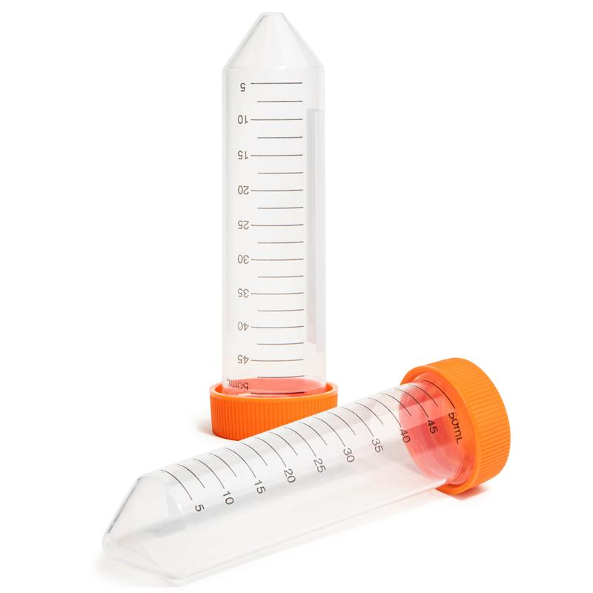
Experimental
Standards
  Agilent Environmental Calibration Standard (# 5183-4688) multi-element stock solution
  Single element standards for Al, Mn, Zn, Hg (Kanto Chemical), and P (SPEX)
  QC sample: Environmental Calibration Standard A (VHG)
  ISTD: Agilent Internal Standard Mix for ICP-MS (# 5188-6525)
Samples
  River Sediment A/ River Sediment B/ Estuarian Sediment/ Soil A/ Soil B
All standards and samples were prepared in 1% HNO₃ and 0.5% HCl (HCl is beneficial for chemical stability of several critical trace elements, Hg, Ag, Mo, Tl…)
As QC samples, CCV and CCB were measured every after 10 samples.

Slide 9
LOQs (10 sigma method)
 | He flow rate (mL/min) | ISTD | LOD (µg/kg)
9 Be | 1 | 6Li | 0.004
23 Na | 5 | 89Y | 7.75
24 Mg | 5 | 89Y | 1.02
27 Al | 5 | 89Y | 4.97
31 P* | 10 | 89Y | 2.75
39 K | 5 | 89Y | 30.3
44 Ca | 5 | 89Y | 17.1
51 V | 5 | 89Y | 0.016
52 Cr | 5 | 89Y | 0.371
55 Mn | 5 | 89Y | 0.222
56 Fe | 5 | 89Y | 3.27
59 Co | 5 | 89Y | 0.010
60 Ni | 5 | 89Y | 0.044
63 Cu | 5 | 89Y | 0.042
 | He flow rate (mL/min) | ISTD | LOD (µg/kg)
66 Zn | 5 | 89Y | 0.210
75 As* | 5 | 89Y | 0.049
78 Se* | 10 | 89Y | 0.049
95 Mo | 5 | 89Y | 0.009
107 Ag | 5 | 115In | 0.016
111 Cd | 5 | 115In | 0.008
121 Sb | 5 | 115In | 0.011
137 Ba | 5 | 115In | 0.059
201 Hg | 5 | 209Bi | 0.004
205 Tl | 5 | 209Bi | 0.005
Pb** | 5 | 209Bi | 0.163
232 Th | 5 | 209Bi | 0.008
238 U | 5 | 209Bi | 0.006
*P and Se were measured by Enhanced He mode. As and Se were measured at the increased resolution settings used for M²⁺ Correction.** Pb was measured as the sum of the three most abundant isotopes, 206, 207 and 208.
Notes:
Note: LOQs are calculated using 10 sigma of 10 measurements of the blank (not 3 sigma).

Slide 10
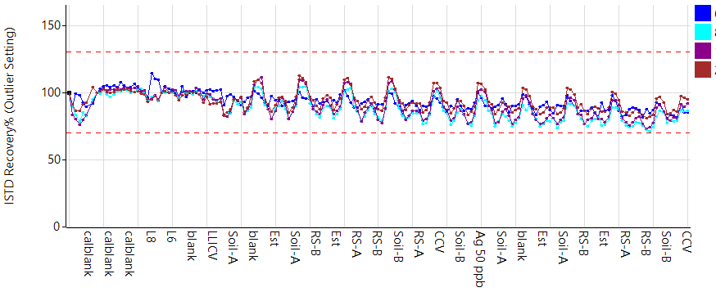
Long-term Stability Confirmed by ISTD Plot and QC Recovery
Analysis of a mixed batch of CRMs, with QC block interspersed after every 10 samples
ISTD
QC sample recovery
8 hours
8 hours
Notes:
QC sample: every 10 samples
QC sample concentration: 50ppb for trace elements, 5000ppb for mineral elements, 500ppb for P, 1ppb for Hg

Slide 11
Accurate Quantitative Results for All Elements in River Sediment A
Concentration units mg/L except for elements in light blue rows which are in μg/L.
(n=20) | Mean Conc | Certified Value | Recovery (%)
9 Be | 0.151 | - | -
23 Na | 51.8 | 50.0±0.3 | 103
24 Mg | 69.6 | 70.0±0.4 | 99
27 Al | 244 | 250±1 | 98
31 P | 0.017 | - | -
39 K | 149 | 150±1 | 99
44 Ca | 292 | 300±2 | 98
51 V | 0.252 | 0.250±0.003 | 101
52 Cr | 298 | 300±2 | 99
55 Mn | 7.74 | 8.00±0.04 | 97
56 Fe | 1190 | 1200±6 | 99
59 Co | 100 | 100±1 | 100
60 Ni | 0.51 | 0.50±0.01 | 102
63 Cu | 1.01 | 1.00±0.01 | 101
(n=20) | Mean Conc | Certified Value | Recovery (%)
66 Zn | 13.7 | 15.0±0.2 | 91
75 As | 0.594 | 0.60±0.03 | 99
78 Se | 19.7 | 20±2 | 98
95 Mo | 0.592 | - | -
107 Ag | 1.63 | - | -
111 Cd | 102 | 100±2 | 102
121 Sb | 518 | 500±20 | 104
137 Ba | 0.514 | 0.50±0.01 | 103
201 Hg | 0.028 | - | -
205 Tl | 9.72 | 10±1 | 97
206,207,208 Pb | 7.12 | 7.00±0.07 | 102
232 Th | 19.9 | 20±2 | 99
238 U | 9.82 | 10±1 | 98
All certified elements measured in the five sediment and soil CRMs were within ±10%

Slide 12
Accurate Quantitative Results for All Elements in River Sediment B
Concentration units mg/L except for elements in light blue rows which are in μg/L.
(n=20) | Mean Conc | Certified Value | Recovery (%)
9 Be | 0.103 | - | -
23 Na | 54.2 | 50.0±0.5 | 108
24 Mg | 127 | 120±1 | 106
27 Al | 594 | 600±4 | 99
31 P | 9.72 | 10.0±0.1 | 97
39 K | 199 | 200±3 | 100
44 Ca | 294 | 300±2 | 98
51 V | 1.03 | 1.00±0.02 | 103
52 Cr | 15.8 | 15.0±0.1 | 105
55 Mn | 5.92 | 6.0±0.1 | 99
56 Fe | 410 | 400±2 | 102
59 Co | 162 | 150±3 | 108
60 Ni | 0.55 | 0.50±0.01 | 110
63 Cu | 1.06 | 1.00±0.01 | 106
(n=20) | Mean Conc | Certified Value | Recovery (%)
66 Zn | 4.7 | 5.00±0.05 | 94
75 As | 0.2 | 0.20±0.01 | 100
78 Se | 9.44 | 10±1 | 94
95 Mo | 2.3 | - | -
107 Ag | 0.318 | - | -
111 Cd | 30.6 | 30±1 | 102
121 Sb | 41 | 40±2 | 102
137 Ba | 4.02 | 4.00±0.04 | 100
201 Hg | 0.021 | - | -
205 Tl | 9.76 | 10±1 | 98
206,207,208 Pb | 2.04 | 2.0±0.1 | 102
232 Th | 97.8 | 100±5 | 98
238 U | 29 | 30±2 | 97
All certified elements measured in the five sediment and soil CRMs were within ±10%

Slide 13
Accurate Quantitative Results for All Elements in Estuarian Sediment
Concentration units mg/L except for elements in light blue rows which are in μg/L.
(n=20) | Mean Conc | Certified Value | Recovery (%)
9 Be | 18.7 | 20.0±0.6 | 93
23 Na | 206 | 200±2 | 103
24 Mg | 102 | 100.0±0.6 | 102
27 Al | 710 | 700±4 | 102
31 P | 4.86 | 5.00±0.05 | 97
39 K | 146 | 150±2 | 97
44 Ca | 79 | 80.0±0.5 | 99
51 V | 1 | 1.00±0.02 | 100
52 Cr | 0.832 | 0.800±0.008 | 104
55 Mn | 3.86 | 4.00±0.04 | 96
56 Fe | 348 | 350±2 | 99
59 Co | 108 | 100±2 | 108
60 Ni | 0.32 | 0.30±0.02 | 107
63 Cu | 0.214 | 0.200±0.003 | 107
(n=20) | Mean Conc | Certified Value | Recovery (%)
66 Zn | 1.37 | 1.50±0.03 | 92
75 As | 0.097 | 0.100±0.005 | 97
78 Se | 45.8 | 50±5 | 92
95 Mo | 1.06 | - | -
107 Ag | 0.182 | - | -
111 Cd | 0.446† | 0.4 | -
121 Sb | 4.42† | 4 | -
137 Ba | 0.004 | - | -
201 Hg | 0.021 | - | -
205 Tl | 0.066 | - | -
206,207,208 Pb | 0.304 | 0.30±0.02 | 102
232 Th | 97.6 | 100±5 | 98
238 U | 0.055 | - | -
†:Reference value
All certified elements measured in the five sediment and soil CRMs were within ±10%

Slide 14
Accurate Quantitative Results for All Elements in Soil A
Concentration units mg/L except for elements in light blue rows which are in μg/L.
(n=20) | Mean Conc | Certified Value | Recovery (%)
9 Be | 0.063 | - | -
23 Na | 72.2 | 70.0±0.7 | 103
24 Mg | 70.2 | 70.0±0.4 | 100
27 Al | 492 | 500±3 | 98
31 P | 9.84 | 10.0±0.1 | 98
39 K | 197 | 200±3 | 98
44 Ca | 344 | 350±2 | 98
51 V | 0.1 | 0.100±0.005 | 100
52 Cr | 0.016 | - | -
55 Mn | 0.104 | 0.100±0.001 | 104
56 Fe | 199 | 200.0±1.2 | 99
59 Co | 2.46 | - | -
60 Ni | 0.298 | 0.30±0.02 | 99
63 Cu | 0.3 | 0.300±0.005 | 100
(n=20) | Mean Conc | Certified Value | Recovery (%)
66 Zn | 0.916 | 1.00±0.002 | 92
75 As | 0.19 | 0.20±0.01 | 95
78 Se | 9.42 | 10±1 | 94
95 Mo | 0.234 | - | -
107 Ag | 0.236 | - | -
111 Cd | 2.98† | 6 | -
121 Sb | 32.6 | 30±1 | 109
137 Ba | 5.06 | 5.00±0.05 | 101
201 Hg | 0.019 | - | -
205 Tl | 0.066 | - | -
206,207,208 Pb | 0.4 | 0.40±0.02 | 100
232 Th | 97.6 | 100±5 | 98
238 U | 9.54 | 10±1 | 95
All certified elements measured in the five sediment and soil CRMs were within ±10%

Slide 15
Accurate Quantitative Results for All Elements in Soil B
Concentration units mg/L except for elements in light blue rows which are in μg/L.
(n=20) | Mean Conc | Certified Value | Recovery (%)
9 Be | 0.398 | - | -
23 Na | 99.8 | 100±1 | 100
24 Mg | 79 | 80.0±0.48 | 99
27 Al | 716 | 700±4 | 102
31 P | 9.66 | 10.0±0.1 | 97
39 K | 206 | 210±3 | 98
44 Ca | 122 | 125±1 | 98
51 V | 0.788 | 0.800±0.016 | 99
52 Cr | 0.404 | 0.400±0.005 | 101
55 Mn | 97.4 | 100±1 | 97
56 Fe | 346 | 350±2 | 99
59 Co | 98.6 | 100±2 | 99
60 Ni | 0.202 | 0.20±0.01 | 101
63 Cu | 2.96 | 3.00±0.03 | 98
(n=20) | Mean Conc | Certified Value | Recovery (%)
66 Zn | 64 | 70.0±0.7 | 91
75 As | 5.74 | 6.00±0.12 | 96
78 Se | 0.254 | - | -
95 Mo | 1.55 | - | -
107 Ag | 0.5 | - | -
111 Cd | 195 | 200±4 | 97
121 Sb | 398 | 400±12 | 100
137 Ba | 6.98 | 7.00±0.07 | 100
201 Hg | 0.02 | - | -
205 Tl | 0.13 | - | -
206,207,208 Pb | 58.6 | 60.0±0.6 | 98
232 Th | 97.4 | 100±5 | 97
238 U | 242 | 250±10 | 97
All certified elements measured in the five sediment and soil CRMs were within ±10%

Slide 16
Matrix Spike Recovery Test of Soil A
 | Soil-A (µg/kg) | Soil-A+ Spike 1 (µg/kg) | Soil-A+ Spike 2 (µg/kg) | Spike 1 Recovery (%) | Spike 2 Recovery (%) | Relative % Difference
9 Be | 0.18 | 92.1 | 90.8 | 92 | 91 | 1.1
51 V | 47.4 | 156 | 158 | 108 | 111 | 2.7
52 Cr | 1.38 | 104 | 107 | 102 | 105 | 2.9
55 Mn | 52 | 156 | 163 | 104 | 111 | 6.5
59 Co | 1.09 | 96.8 | 94.2 | 96 | 93 | 3.2
60 Ni | 157 | 264 | 268 | 107 | 112 | 4.6
63 Cu | 157 | 266 | 266 | 109 | 109 | 0
66 Zn | 524 | 691 | 688 | 111 | 109 | 1.8
75 As | 93.1 | 184 | 184 | 91 | 91 | 0
78 Se | 4.41 | 99.7 | 98.6 | 95 | 94 | 1.1
Matrix spikes were mostly within ±10%.

Slide 17
Matrix Spike Recovery Test in Soil A ... continued
 | Soil-A (µg/kg) | Soil-A+ Spike 1 (µg/kg) | Soil-A+ Spike 2 (µg/kg) | Spike 1 Recovery (%) | Spike 2 Recovery (%) | Relative % Difference
95 Mo | 0.1 | 100 | 97.8 | 100 | 98 | 2
107 Ag | 0.25 | 97.2 | 91.3 | 97 | 91 | 6.4
111 Cd | 1.43 | 103 | 102 | 101 | 101 | 0
121 Sb | 16.5 | 119 | 120 | 103 | 104 | 1
201 Hg | 0.01 | 2.06 | 2.08 | 102 | 103 | 1
205 Tl | 0.03 | 103 | 103 | 103 | 103 | 0
Pb* | 203 | 304 | 302 | 101 | 99 | 2
232 Th | 48.9 | 152 | 153 | 104 | 104 | 0
238 U | 4.82 | 107 | 108 | 102 | 103 | 1
*Pb was measured as the sum of the three most abundant isotopes, 206, 207 and 208.
Matrix spikes were within ±10%.

Slide 18
Conclusion
The Agilent 7850 ICP-MS accurately measured 28 elements in varied soil and sludge samples – typical, but difficult environmental samples.
A robust plasma (low CeO⁺/Ce⁺ ratio) ensured that variable soil sample matrices can be analyzed reproducibly over 8 hours, while ensuring consistency by minimizing matrix suppression.
The 7850 avoided common time-consuming and unproductive activities in the analytical workflow by predefining and automating many functions using a method wizard and autotune.
Polyatomic and M²⁺ interferences were removed using helium/KED and half-mass correction.
ISIS 3 provided high sample throughput and minimized deposits on the interface.
EMF and a post-run check reduced unnecessary maintenance, further improving productivity.

Slide 19
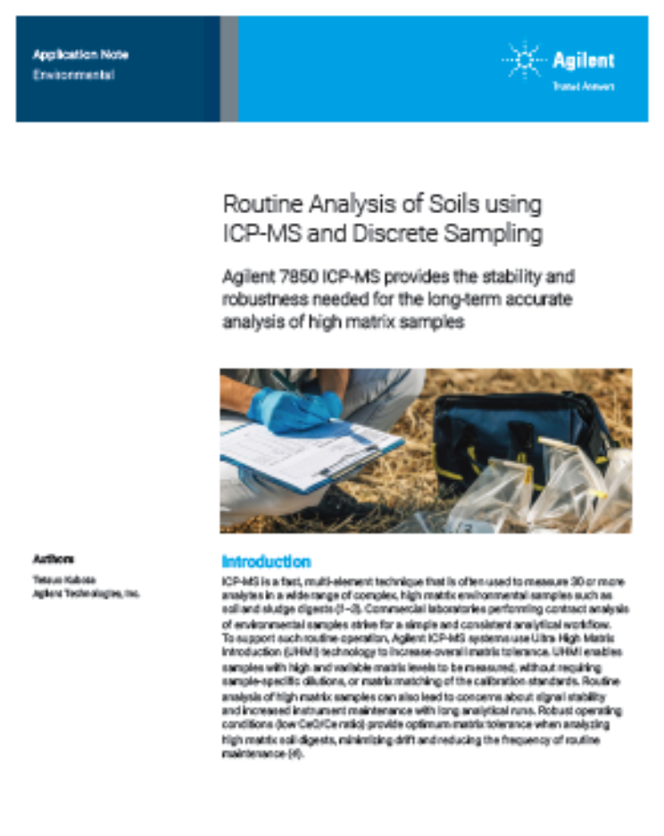
More Information
Agilent Application Note
Agilent application note: 5994-2933EN

