Slide 1
Fast, Accurate Analysis of 28 elements in Water using ISO Method 17294-2 for ICP-MS
Agilent 7850 ICP-MS controls polyatomic and doubly charged interferences to deliver long-term accuracy and reproducibility in diverse water samples
DE44181.001087963

Slide 2



Routine Water Analysis – Not Always a “Simple” Application
Water is often perceived as a simple matrix that is easy to analyze routinely, but
Matrix can be high (e.g., estuarine/coastal seawater)
Matrix can be variable (e.g., drinking water vs wastewater, industrial discharge, agricultural runoff)
Analytes must be measured accurately from low to high concentration (traces and major elements)
Analysis requires ICP-MS with good matrix tolerance, effective control of matrix-based interferences, and wide dynamic range
Also, routine labs require easy method setup and operation (for new and inexperienced users) and ability to ensure reliable results without needing an expert operator

Slide 3

Environmental Testing Laboratories Face…
Challenge of managing many samples
Development of new methods to meet new regulations
Ensuring data quality
Maintaining a high level of productivity and data quality is vital to the success of many labs
So, labs can benefit from reducing the time required for key steps of the workflow
Preparing calibration standards and samples
Developing methods
Performing daily checks
Reviewing data
Reporting results

Slide 4
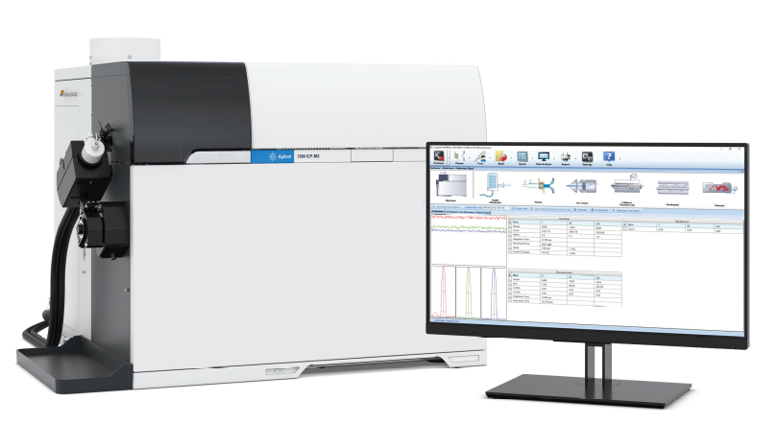
Benefits of the Agilent 7850 ICP-MS
Easy to setup and use
    Method Wizard, Preset Methods and Autotune, M²⁺ correction
Effective ORS⁴ helium collision mode
    Effective removal of common polyatomic ion interferences
10 orders dynamic range
    Enables the measurement of major and trace elements in the same run
Robust, matrix tolerant plasma (low CeO⁺/Ce⁺)
    Gives consistent results in a wide range of different sample types
In this study, the 7850 ICP-MS was used to analyze 28 elements in various water samples according to ISO 17294-2

Slide 5

ISO 17294
Part 1: general directions for the use of the ICP-MS technique
Part 2: determination of trace and major elements in water samples. ISO 17294-2 can be applied to more than 60 analytes, including many novel contaminants such as Rare Earth Elements (REEs)
REEs are increasingly used in new industrial processes and products
May lead to environmental contamination from mining activities, oil refining, manufacturing and disposal of electronic devices, and hospital waste
Potential for raised levels of REEs in surface water, groundwater, and other environmental samples
REEs can cause problems for water labs as they are novel, unfamiliar analytes, and can be a potential source of interferences

Slide 6
Quadrupole ICP-MS and REEs
In a quadrupole mass filter, ions are separated based on their mass to charge ratio (m/z) so an ion that loses 2 electrons (giving a double + charge, M²⁺) appears at half its true mass
REEs have relatively low second ionization potentials, so form doubly charged ions (REE²⁺) more easily than most other elements (around a few %)
REEs have masses between 139 and 176, so the REE²⁺ ions appear between m/z 69 and 88, where they can overlap the masses of the singly charged (M⁺) ions of trace analytes As⁺ (m/z 75) and Se⁺ (m/z 78)
M²⁺ correction function of Agilent ICP-MS MassHunter software automatically corrects REE²⁺ interferences on As⁺ and Se⁺

Slide 7
M²⁺ Correction is Built In Function of Agilent Method Wizard
Example for correcting ¹⁵⁰Nd²⁺ and ¹⁵⁰Sm²⁺ contribution on ⁷⁵As⁺
Natural isotope abundance
Narrow peak mode (½ mass resolution) is applied
M²⁺ masses for odd-numbered M⁺ ions of Nd and Sm are automatically selected: ¹⁴⁵Nd²⁺ is measured at m/z 72.5 and ¹⁴⁷Sm²⁺ is measured at m/z 73.5
Intensities of ¹⁵⁰Nd²⁺ and ¹⁵⁰Sm²⁺ are automatically calculated from the natural ^{145/150}Nd and ^{147/150}Sm isotope abundances
Counts for ¹⁵⁰Nd²⁺ and ¹⁵⁰Sm²⁺ are subtracted from the total signal at m/z 75, leaving corrected ⁷⁵As⁺
Mass | 145 | 147 | 150
Nd | 8.3 |  | 5.6
Sm |  | 15.0 | 7.38
¹⁴⁵Nd
¹⁴⁷Sm
¹⁵⁰Nd²⁺
¹⁵⁰Sm²⁺
¹⁴⁵Nd²⁺
¹⁴⁷Sm²⁺
⁷⁵As⁺
Selecting “M²⁺ Correction” in the Method Wizard automatically sets all the parameters needed, making it fast to set up and easy to use
72.5
73.5
75
m/z
Notes:
The same correction method is used for Se. For 78Se, 155Gd and 163 Dy are measured at m/z 77.5 and 81.5, respectively.

Slide 8
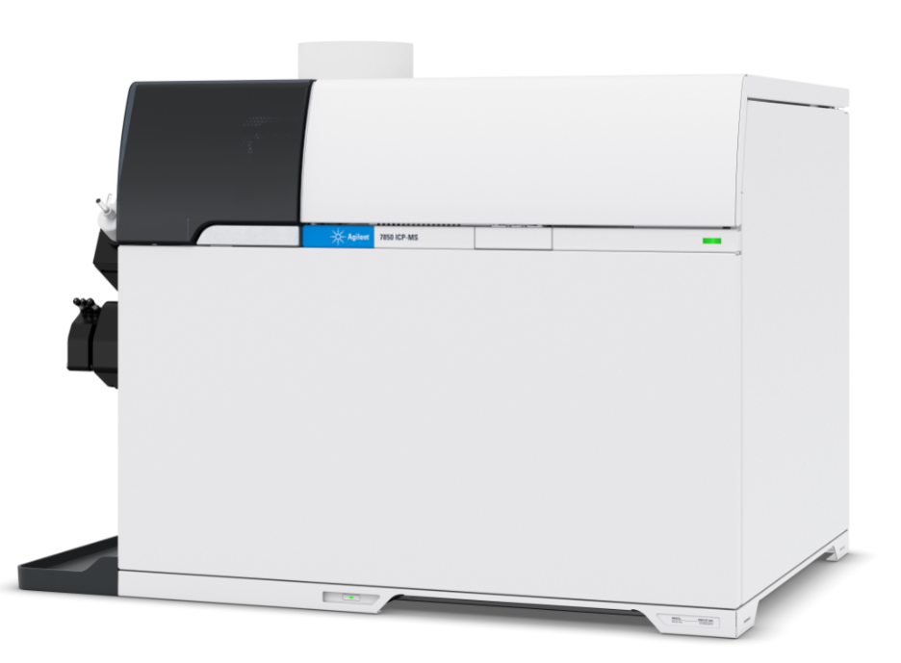
Experimental
Parameters | No Gas | He | He
Plasma Mode | General purpose
RF Power (w) | 1550
Spray Chamber Temp. (˚C) | 2
Sampling Depth (mm) | 10
Nebulizer Gas Flow (L/min) | 1.09
Lens Tune | Autotune
Cell Gas Flow (mL/min) | 0.0 | 4.3 (10**)
Energy Discrimination (V) | 5.0 | 5.0 (7.0**)
Instrument
  Agilent 7850 ICP-MS
  SPS 4 autosampler
Cell modes
  No gas (for Li, Be and B)*
  Helium
  Enhanced helium mode (for Se)
M²⁺ correction function automatically sets
  acquisition masses for corrections
  narrow peak mode
  correction equations
  ** Enhanced He mode used for Se
  * For fastest analysis, He mode can also be used for Li, Be, B

Slide 9
Experimental
Standards
  Agilent Environmental Calibration Standard (# 5183-4688) multi-element stock solution
  Single element standards for Li, B and Hg (Kanto Chemical), and P (SPEX)
  ISTD: Agilent Internal Standard Mix for ICP-MS (# 5188-6525) + Ir single element standard (Acros Organics)
Samples
  NIST 1640a Natural Water
  SLRS-6 River Water CRM for Trace Metals and other Constituents (National Research Council of Canada)
  Two brands of bottled water (sample A and B) and a tap water (sample C) for long-term analysis
All standards and samples were prepared in 1% HNO₃ and 0.5% HCl (HCl is highly beneficial for chemical stability of several critical trace elements, Hg, Ag, Mo, Tl…)
Undiluted 1640a was spiked with 100 ppb Nd/Sm and 10 ppb Gd/Dy to prove the M²⁺ correction function

Slide 10
LOQs (10 sigma method)
Element | Gas Mode | LOQ (ppb) | ISO Method Specs (ppb)
7 Li | No gas | 0.004 | 1
9 Be | No gas | 0.003 | 0.1
11 B | No gas | 0.088 | 1
23 Na | He | 1.5 | 10
24 Mg | He | 0.29 | 1
27 Al | He | 0.31 | 1
31 P | He | 0.57 | 5
39 K** | He | 3.87 | 5
44 Ca | He | 9.0 | 50
51 V | He | 0.028 | 0.1
52 Cr | He | 0.030 | 0.1
55 Mn | He | 0.035 | 0.1
56 Fe | He | 0.10 | 5
59 Co | He | 0.010 | 0.2
Element | Gas Mode | LOQ (ppb) | ISO Method Specs (ppb)
60 Ni | He | 0.056 | 0.1
63 Cu | He | 0.028 | 0.1
66 Zn | He | 0.21 | 1
75 As | He | 0.018 | 0.1
78 Se | He* | 0.055 | 0.1
95 Mo | He | 0.004 | 0.5
107 Ag | He | 0.007 | 0.5
111 Cd | He | 0.002 | 0.1
121 Sb | He | 0.043 | 0.2
137 Ba | He | 0.060 | 3
202 Hg | He | 0.004 | 0.05
205 Tl | He | 0.026 | 0.1
Pb | He | 0.007 | 0.1
238 U | He | 0.0004 | 0.1
*K LOQ was a little high due to blank contamination
**Enhanced He mode
Notes:
Note: LOQs are calculated using 10 sigma of 10 measurements of the blank (not 3 sigma).

Slide 11
Automatic Correction of M²⁺ Interferences on As and Se
Recoveries of As and Se in 1640a spiked with REEs
Accurate recoveries of the certified values for As and Se in the presence of REE spike shows effectiveness of ICP-MS MassHunter automated M²⁺ correction function
with M²⁺ correction
without M²⁺ correction
Notes:
Concentrations: As 8.01ppb, Se 19.97ppb in NIST 1640a
Spiked REEs: 100ppb of Nd and Sm, and 10ppb of Gd and Dy

Slide 12
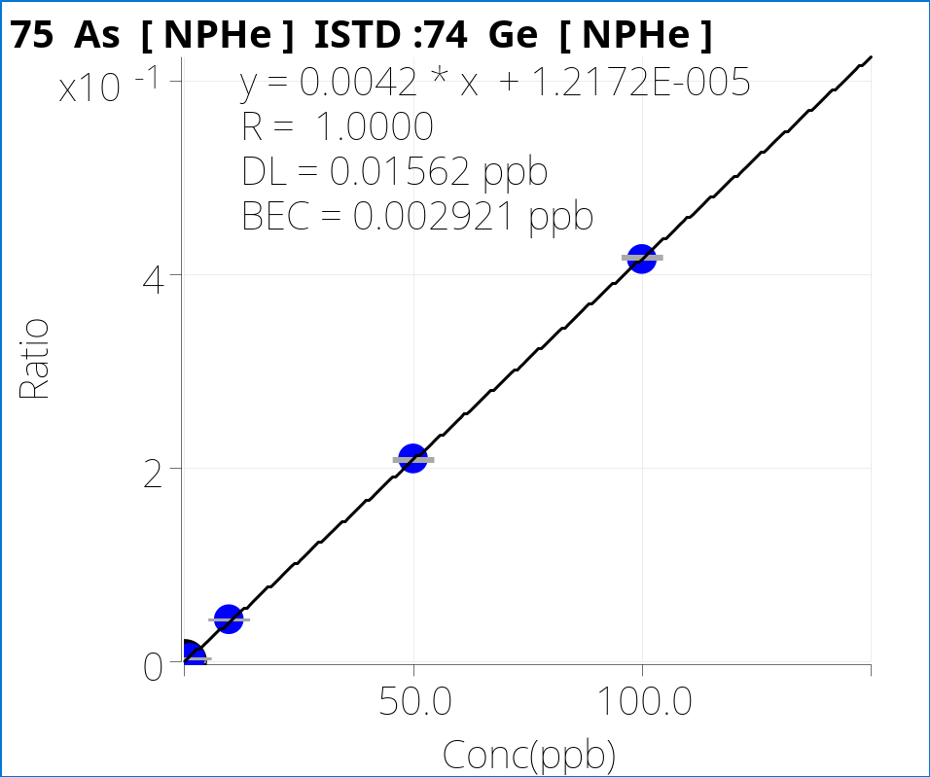
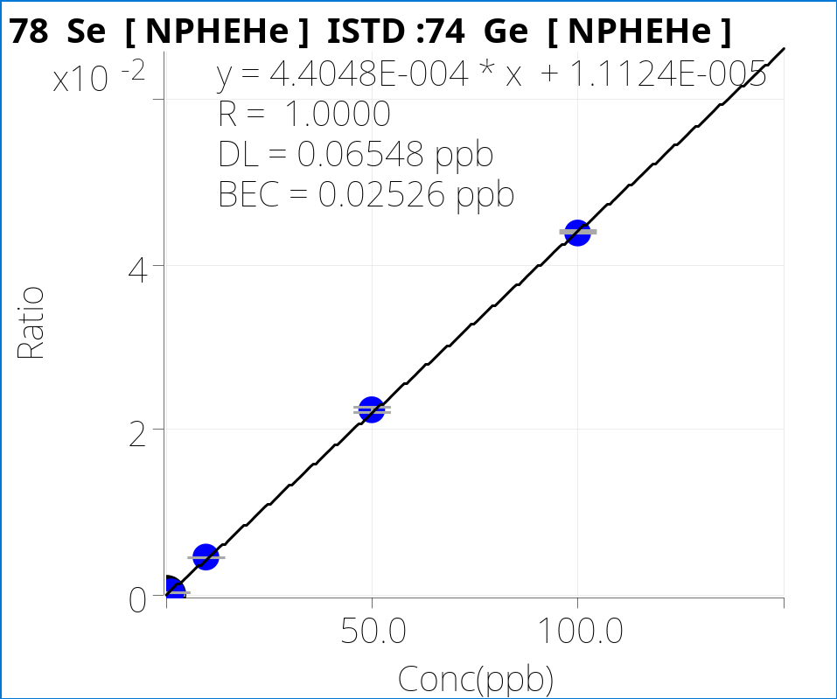
Calibration Curves For As and Se Using Half-Mass Mode
As
Se
Low ppt DLs for As and Se obtained
High frequency hyperbolic quadrupole of 7850 gives high ion transmission under increased resolution (half-mass) settings

Slide 13
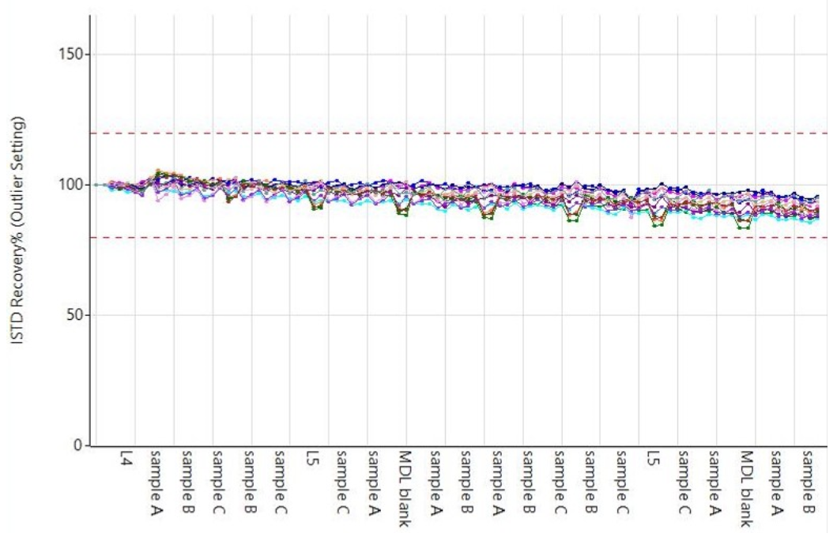
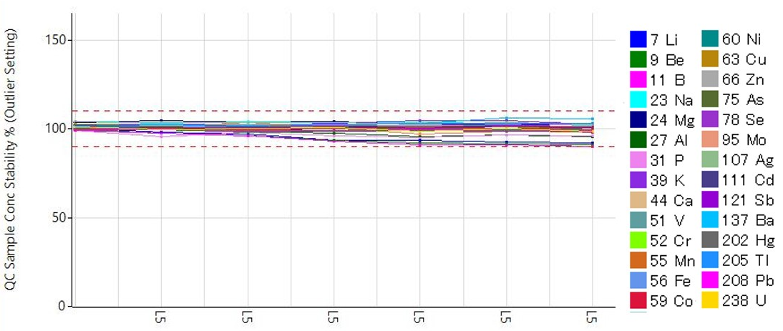
Long-term Stability Confirmed by ISTD Plot and QC Recovery
Analysis of a mixed batch of CRMs, bottled waters, and tap water, with QC block interspersed after every 10 samples
ISTD
QC sample recovery
8 hours
8 hours
Notes:
QC sample: every 10 samples
QC sample concentration: 50ppb for trace elements, 5000ppb for mineral elements, 500ppb for P, 1ppb for Hg

Slide 14
Accurate Quantitative Results for All Elements in SLRS-6
Element | Measured (ppb) | Certified (ppb) | Recovery (%)
7 Li | 0.481 | - | -
9 Be | 0.006 | 0.0066 | 98
11 B | 6.07 | - | -
23 Na | 2620 | 2770 | 95
24 Mg | 2060 | 2137 | 97
27 Al | 31.0 | 33.8 | 92
31 P | 2.23 | - | -
39 K | 607 | 651 | 93
44 Ca | 8180 | 8770 | 93
51 V | 0.335 | 0.352 | 95
52 Cr | 0.232 | 0.252 | 92
55 Mn | 2.06 | 2.12 | 97
56 Fe | 80.3 | 84.5 | 95
59 Co | 0.057 | 0.053 | 108
Element | Measured (ppb) | Certified (ppb) | Recovery (%)
60 Ni | 0.551 | 0.617 | 90
63 Cu | 24.3 | 24 | 102
66 Zn | 1.71 | 1.76 | 97
75 As | 0.536 | 0.57 | 94
78 Se | 0.087 | - | -
95 Mo | 0.192 | 0.215 | 89
107 Ag | < DL | - | -
111 Cd | 0.008 | 0.0063 | 129
121 Sb | 0.316 | 0.3377 | 94
137 Ba | 13.3 | 14.3 | 93
202 Hg | < DL | - | -
205 Tl | < DL | - | -
Pb | 0.164 | 0.17 | 97
238 U | 0.065 | 0.0699 | 93

Slide 15
Accurate Quantitative Results for All Elements in 1640a
Element | Measured (ppb) | Certified (ppb) | Recovery (%)
7 Li | 0.399 | 0.4034 | 99
9 Be | 2.84 | 3.002 | 95
11 B | 278 | 300.7 | 92
23 Na | 3040 | 3112 | 98
24 Mg | 1010 | 1050.2 | 96
27 Al | 52.0 | 52.6 | 98
31 P | 4.38 | - | -
39 K | 569 | 575.3 | 99
44 Ca | 5840 | 5570 | 105
51 V | 14.1 | 14.93 | 95
52 Cr | 38.0 | 40.22 | 94
55 Mn | 38.9 | 40.07 | 97
56 Fe | 36.6 | 36.5 | 100
59 Co | 19.1 | 20.08 | 95
Element | Measured (ppb) | Certified (ppb) | Recovery (%)
60 Ni | 23.6 | 25.12 | 94
63 Cu | 81.8 | 85.07 | 96
66 Zn | 53.2 | 55.2 | 96
75 As | 7.66 | 8.01 | 96
78 Se | 19.9 | 19.97 | 100
95 Mo | 41.9 | 45.24 | 93
107 Ag | 7.38 | 8.017 | 92
111 Cd | 3.66 | 3.961 | 92
121 Sb | 4.69 | 5.064 | 93
137 Ba | 143 | 150.6 | 95
202 Hg | 0.004 | - | -
205 Tl | 1.58 | 1.606 | 98
Pb | 11.9 | 12.005 | 99
238 U | 22.8 | 25.15 | 90

Slide 16
As and Se in 1640a spiked with REEs
Confirming accuracy of automated M²⁺ correction for elements that could suffer doubly-charged ion overlaps
 | 1640a |  |  | 1640a + REEs*
Element | Measured (ppb) | Certified (ppb) | Recovery (%) | Measured (ppb) | Recovery (%)
75 As | 7.66 | 8.01 ± 0.0067 | 96 | 7.78 | 97
78 Se | 19.9 | 19.97 ± 0.16 | 100 | 19.4 | 97
*spiked REEs: 100ppb Nd and Sm, 10ppb Gd and Dy

Slide 17
Conclusions
The Agilent 7850 ICP-MS was used to measure 28 elements in varied water samples, easily meeting the detection limit and QC requirements defined in ISO 17294-2
The 7850 removes many of the common time-consuming and unproductive activities in the analytical workflow by predefining and automating many functions using Method Wizard and Autotune
The ORS⁴ He collision mode provides reliable and effective removal of common polyatomic overlaps in typical ICP-MS sample types
The robust plasma (low CeO⁺/Ce⁺ ratio) ensures that variable water sample matrices can be analyzed reproducibly over a long sample sequence, while ensuring consistency by minimizing matrix suppression

