Slide 1
UPW analysis using Agilent 8900 with m lens
Kazuhiro Sakai
Yoshinori Shimamura
Agilent Technologies Japan, Ltd.
DE44369.9217592593

Slide 2
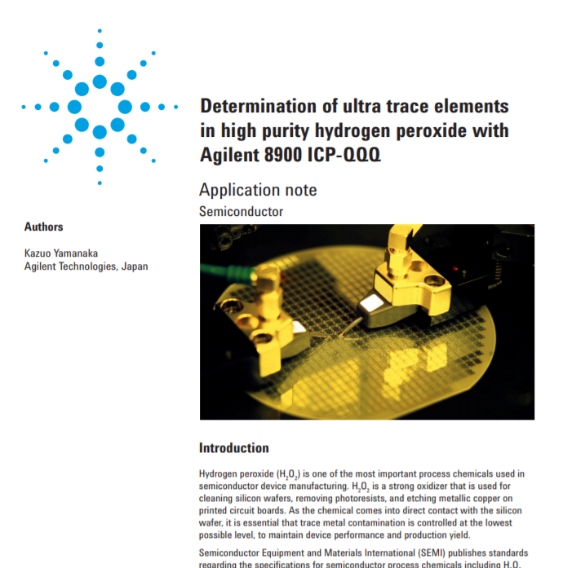
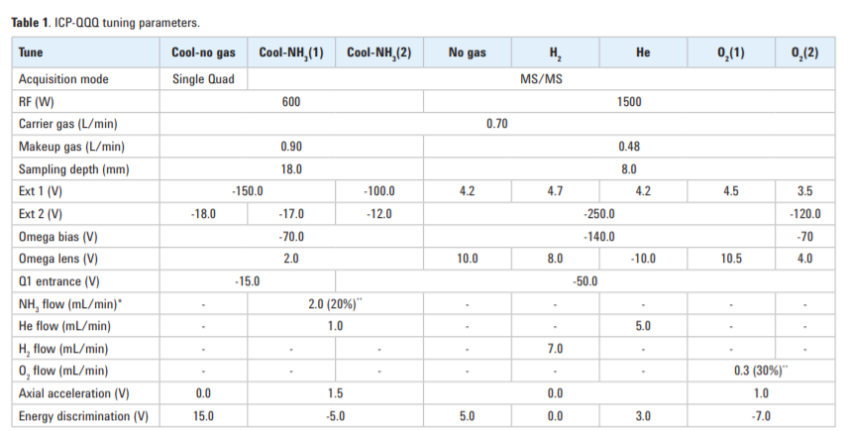

Background: Agilent 8900 with s lens
8 Tunes = 3 Cool Plasma Tunes + 5 Hot Plasma Tunes
= Best Data =
Published Dec. 2016
Can we provide a simple method?
-> Yes
Notes:
8 Tunes (hot plasma and cool plasma ) for UPW analysis
・ Complicated method, Poor sample throughput
・ Hot Plasma is robust condition (don’t need low matrix samples such as UPW,H2O2,HNO3, HCl etc.)
We tried to develop a simple method with Hot plasma for UPW analysis.

Slide 3

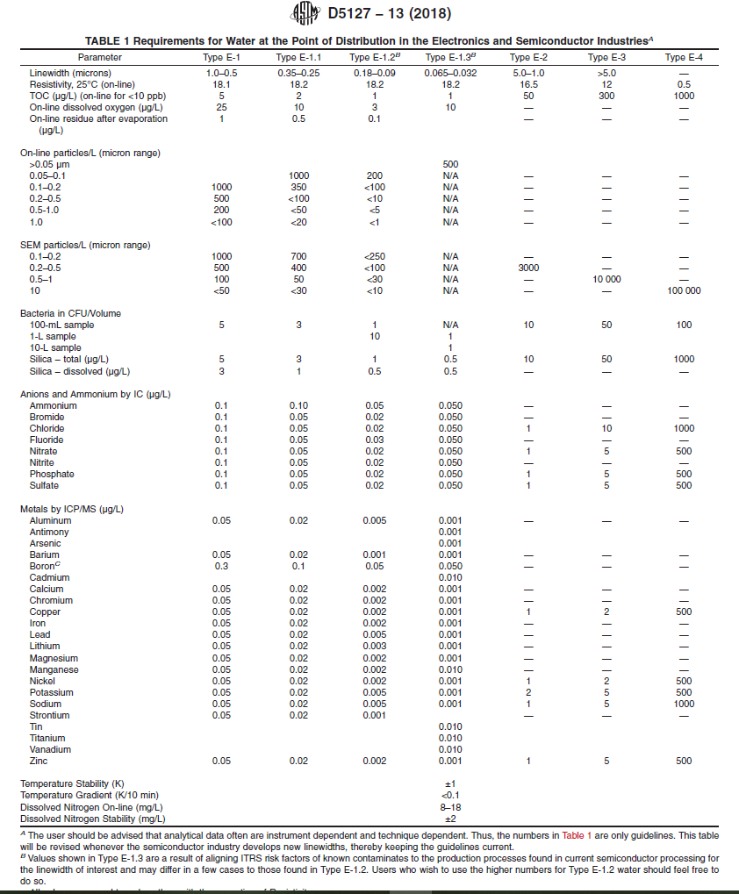
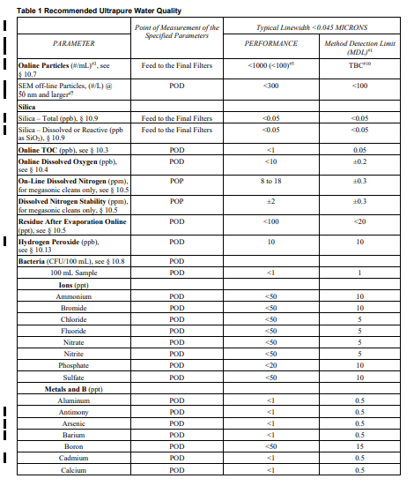
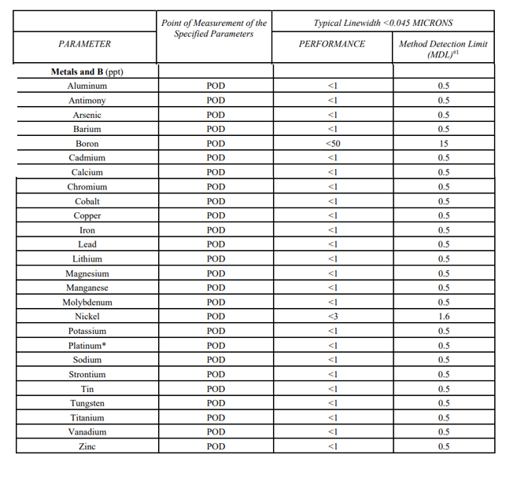
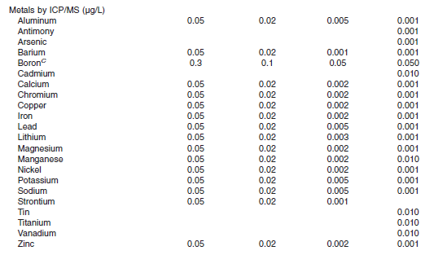
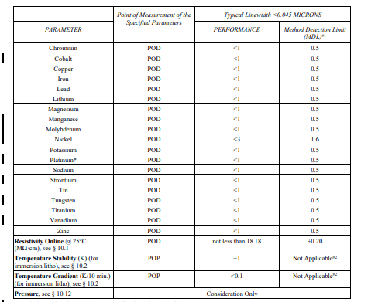
ASTM and SEMI Standards =UPW=
ASTM D5127-13 (2018)
BEC : < 1 ppt
(B: 50 ppt / Ti, V, Mn, Cd, Sn :10 ppt)
SEMI F63-0521 (2021)
BEC : < 1 ppt (B 50 ppt, Ni 3 ppt)
D.L. : < 0.5 ppt (B 15 ppt, Ni 1.6 ppt)
ASTM D5127-13 (2018)
SEMI F63-0521 (2021)
BEC : < 1 ppt (B 50 ppt)
D.L. : < 0.5 ppt (B 15 ppt)
BEC < 0.5 ppt
(most of the elements)
D.L. < 0.3 ppt
Hot Plasma Condition
Notes:
What you see in this slide is the regulation about Ultra Pure Water analysis.
According to the ASTM regulation and SEMI standards, the spec required for ultrapure water is BEC is less than 1 ppt and D.L. is less than 0.5 ppt.
Regarding boron, BEC is lower than 50 ppt and D.L. is lower than 15 ppt.
Therefore, these values are the analytical values we must reach.

Slide 4
Tuning parameters : 8900 (m lens)
 | No Gas | NH3+H2 | O2
RF Power | 1600
Smpl Depth | 8.0
Nebulizer Gas | 0.70
Makeup Gas | 0.48
Extract 1 | 3.5 | 4.0 | 3.0
Extract 2 | -20 | -40 | -100
Omega Bias | -30 |  | -40
Omega Lens | 3.0 |  | 5.9
Q1 Entrance | -30 |  | -50
Q1 Exit | -5 |  | 5
Cell Focus | -5 | -1 | 4
Cell Entrance | -70 | -50 | -50
Cell Exit | -100 | -50 | -64
Deflect | 13 | -5 | 5.2
Plate Bias | -50
Q1 Bias | -5 |  | 0
Q1 Prefilter Bias | -6 |  | -5.5
Q1 Postfilter Bias | -7 |  | -9
He Flow | 0 | 1 | 0
H2 Flow | 0 | 2 | 0
3rd Gas Flow | 0 | 20 | 0
4th Gas Flow | 0 | 0 | 30
OctP Bias | -12 | -10 | -3
Axial Acceleration | 0 | 2 | 2
OctP RF | 130 | 170 | 180
Energy Discrimination | 3 | -10 | -7
Wait Time Offset | 0 | 2 | 2
3 Tunes ：only Hot Plasma condition
Parameter | Description
Sample Uptake Rate | 200 μL/min
Nebulizer | MFN-100 (standard)
Spray Chamber and Torch | Standard (Quartz, 2.5mm id Torch)
Cones | Pt tipped sampling cone, Pt-tipped, Ni-based skimmer cone for m-lens (G3666-67501).
Integration time | 1 sec / isotope
CeO⁺/Ce⁺ | around 2 % (hot plasma)
Reaction Gases | Ammonia, Oxygen, Hydrogen
The 8900 ICP-QQQ (#200) was fitted with the standard Pt tipped sampling cone, optional m-lens (part number G3666- 67500), and optional Pt-tipped, Ni-based skimmer cone for m-lens (part number G3666-67501).
Notes:
<Point >
Regarding plasma temperature, 1600W is not always hot plasma conditions.
The plasma temperature is determined by the sampling depth, the carrier gas flow rate, and the make up gas flow rate in addition to the RF power.
It is important to check the plasma temperature indicator such as CeO ratio.
No-gas mode is a condition for measuring Na with low BEC, so sensitivity is sacrificed.
Since NH3 + H2 mode is used to measure K, Ca, and many other elements.
we tried to measure Pt with O2 mode. Fortunately, there are few elements that need to be measured in O2 mode, and there are no elements data changes significantly depending on tuning conditions.
Therefore, we searched for a condition that lowers the BEC of Pt with O2 mode. It can be said as a condition in which the sensitivity of Pt is almost high.
If you sacrifice sensitivity, D.L. will increase, so I searched for conditions that would make sensitivity as high as possible while checking BEC.
Therefore, by changing only the O2 mode, we aimed to have SEMI and ASTM regulation meet with 3 Tunes.
The next slide shows the results.

Slide 5
BEC
1.1 ppt
SEMI Value (F63-0521) is < 1.0 ppt (B:50 ppt)
BEC < 0.5 ppt (most of the elements)
Notes:
Here is a summary about BEC.
As you can see from this figure, our data meets SEMI and ASTM regulations (<1.0 ppt, B: 50 ppt). it’s about (<0.5ppt most of elements).

Slide 6
D.L.
1.2 ppt
SEMI Value (F63-0521) is < 0.5 ppt (B:15ppt)
D.L. < 0.3 ppt (most of the elements)
Notes:
D.L. is shown on this slide.
As you can see from this figure, our data meets SEMI and ASTM regulations (<0.5 ppt, B: 15 ppt). It’s about (<0.3 ppt most of elements).

Slide 7
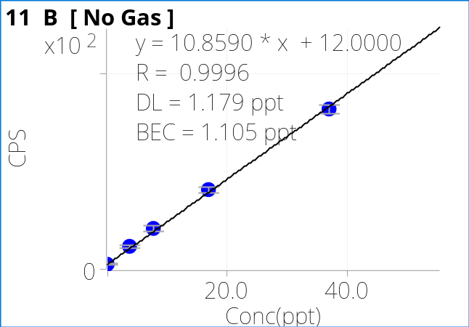
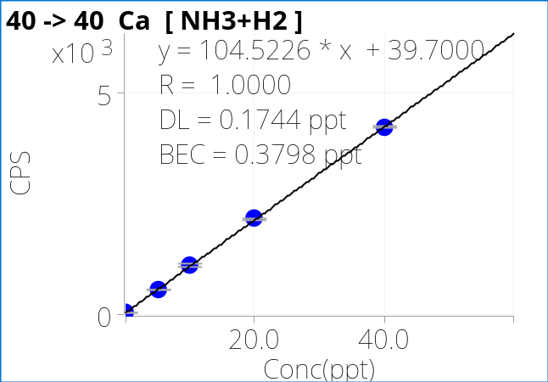
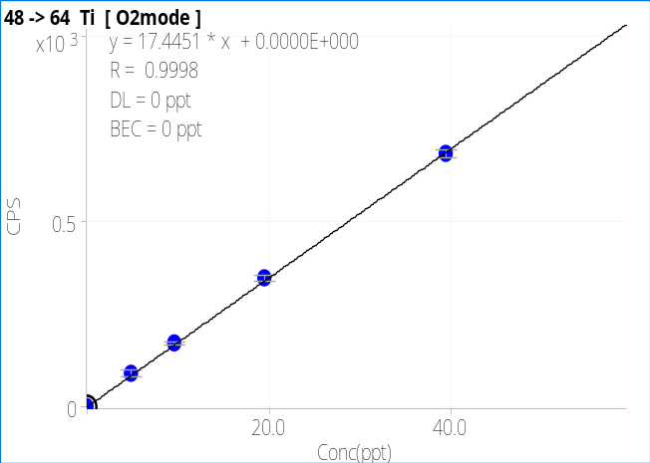
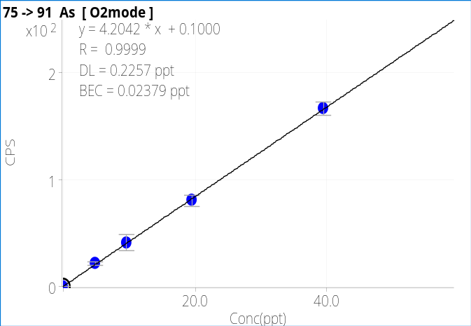
Sensitivity and Calibration Curves
 | 8900
B | 11 CPS /ppt (no-gas)
Ca | 105 CPS /ppt (NH3 + H2)
Ti | 17 CPS /ppt (O2)
As | 4 CPS /ppt (O2)
Notes:
An example of a typical calibration curve is shown here. The calibration range is 5,10,20,40 ppt.
*MSA (method of standard additions)

Slide 8
UPW (1/1000 HNO3)
Tune Mode | Scan Type | Q1 | Q2 | Name | R | a | b (blank) | DL | BEC | Units | Cal 3SD CPS | Theo DL ppt | DATA/Theo
No Gas | Single Quad |  | 7 | Li | 0.9994 | 18 | 0.0 | 0.00 | 0.00 | ppt | 0.0 | 0.00 | #DIV/0!
No Gas | Single Quad |  | 11 | B | 0.9996 | 11 | 12 | 1.18 | 1.11 | ppt | 10.4 | 0.96 | 1.2
No Gas | Single Quad |  | 23 | Na | 0.9992 | 52 | 12.1 | 0.26 | 0.23 | ppt | 10.4 | 0.20 | 1.3
NH3+H2 | MS/MS | 24 | 24 | Mg | 0.9999 | 49 | 0.8 | 0.05 | 0.02 | ppt | 2.7 | 0.06 | 0.9
NH3+H2 | MS/MS | 27 | 27 | Al | 1.0000 | 74 | 4.7 | 0.11 | 0.06 | ppt | 6.5 | 0.09 | 1.2
NH3+H2 | MS/MS | 39 | 39 | K | 1.0000 | 87 | 11.3 | 0.12 | 0.13 | ppt | 10.1 | 0.12 | 1.0
NH3+H2 | MS/MS | 40 | 40 | Ca | 1.0000 | 105 | 39.7 | 0.17 | 0.38 | ppt | 18.9 | 0.18 | 1.0
O2mode | MS/MS | 48 | 64 | Ti | 0.9998 | 17 | 0 | 0.00 | 0.00 | ppt |  | 0.00 | #DIV/0!
NH3+H2 | MS/MS | 51 | 51 | V | 0.9995 | 54 | 0.4 | 0.04 | 0.01 | ppt | 1.9 | 0.04 | 1.1
NH3+H2 | MS/MS | 52 | 52 | Cr | 0.9997 | 99 | 37.7 | 0.24 | 0.38 | ppt | 18.4 | 0.19 | 1.3
NH3+H2 | MS/MS | 55 | 55 | Mn | 0.9999 | 130 | 11.2 | 0.08 | 0.09 | ppt | 10.0 | 0.08 | 1.1
NH3+H2 | MS/MS | 56 | 56 | Fe | 0.9997 | 103 | 37.4 | 0.23 | 0.36 | ppt | 18.3 | 0.18 | 1.3
NH3+H2 | MS/MS | 59 | 59 | Co | 1.0000 | 70 | 1.0 | 0.05 | 0.01 | ppt | 3.0 | 0.04 | 1.2
NH3+H2 | MS/MS | 60 | 60 | Ni | 0.9997 | 17 | 1.3 | 0.14 | 0.07 | ppt | 3.4 | 0.20 | 0.7
NH3+H2 | MS/MS | 63 | 63 | Cu | 0.9994 | 43 | 10.5 | 0.22 | 0.24 | ppt | 9.7 | 0.23 | 1.0
NH3+H2 | MS/MS | 64 | 64 | Zn | 0.9999 | 31 | 1.9 | 0.15 | 0.06 | ppt | 4.1 | 0.13 | 1.2
O2mode | MS/MS | 75 | 91 | As | 0.9999 | 4 | 0.1 | 0.23 | 0.02 | ppt | 0.9 | 0.23 | 1.0
NH3+H2 | MS/MS | 88 | 88 | Sr | 0.9998 | 127 | 0.2 | 0.01 | 0.00 | ppt | 1.3 | 0.01 | 0.9
NH3+H2 | MS/MS | 98 | 98 | Mo | 0.9989 | 29 | 0.2 | 0.04 | 0.01 | ppt | 1.3 | 0.05 | 0.9
NH3+H2 | MS/MS | 114 | 114 | Cd | 0.9996 | 25 | 0.1 | 0.04 | 0.00 | ppt | 0.9 | 0.04 | 1.0
NH3+H2 | MS/MS | 118 | 118 | Sn | 0.9996 | 25 | 0.8 | 0.12 | 0.03 | ppt | 2.7 | 0.11 | 1.2
NH3+H2 | MS/MS | 121 | 121 | Sb | 0.9997 | 20 | 0.1 | 0.05 | 0.01 | ppt | 0.9 | 0.05 | 1.0
NH3+H2 | MS/MS | 138 | 138 | Ba | 1.0000 | 68 | 0.2 | 0.03 | 0.00 | ppt | 1.3 | 0.02 | 1.4
O2mode | MS/MS | 184 | 216 | W | 0.9998 | 69 | 21 | 0.20 | 0.30 | ppt | 13.6 | 0.20 | 1.0
O2mode | MS/MS | 195 | 195 | Pt | 0.9996 | 55 | 22 | 0.20 | 0.40 | ppt | 14.1 | 0.26 | 0.8
NH3+H2 | MS/MS | 208 | 208 | Pb | 1.0000 | 21 | 0.1 | 0.05 | 0.00 | ppt | 0.9 | 0.05 | 1.0
Notes:
An example of the measurement result is shown here.
Sensitivity, BEC, DL can be read from this table. The theoretical DL, which can be calculated from blank's CPS and sensitivity, is included in the table as “Theo DL”.
If there is a large difference between Theo DL and the DL of the experimental results, it may not be possible to reproduce the DL at customer site.
However, the result this time is about ± 40%, so the reproducibility is also reliable.
Theoretical D.L. was calculated from the standard deviation of the blank CPS based on the square root of the Blank CPS.
The measurement D.L. is shown in the purple box. The light blue box shows the theoretical D.L. and the red box shows the ratio between the measured and the theoretical value.
Looking at the numbers in the red frame, it can be seen the error is about ± 40 % (it’s not 0.5 or 0.3 (2-3 times )), it’s almost the same as the theoretical value.

Slide 9
Summary
Target Value | Our Results
Simple Method; Hot Plasma only (3 Tunes) | achieved 3 tunes only for Hot Plasma by using m lens
BEC : SEMI : <1.0 ppt (B: 50 ppt) | Most of the elements < 0.5ppt
D.L. : SEMI : < 0.5 ppt (B:15ppt) | Most of the elements < 0.3ppt
Tips
・Sample Uptake Rate: about 200 μL/min (MFN-100 ; standard) ・1600W and CeO+/Ce = around 2% (True Hot Plasma condition)
Notes:
Here is the summary.
By using the simple method (3 tunes), we were able to collect data that meets ASTM and SEMI standards 8900 #200 standard configuration with m lens.
We were able to obtain the data using three simple tuning methods that used only true hot plasma conditions. (CeO /Ce = 2%)
Furthermore, by changing the nebulizer (ex. 400μL/min), further data improvement can be expected.

Slide 10
appendix

Slide 11
m lens related parts
 | for 8900 | for 7900
Pt Sampling cone | G3280-67036 | ←
Pt (Ni base) Skimmer for m-lens | G3666-67501 | ←
Extraction-Omega lens assy with m-lens, brass skimmer base | G3666-67500 | G8400-67047
Brass Skimmer base | G3666-60401 | G8400-60634
Extraction 1 lens (m-lens) | G3666-60502 | ←
Extraction 2 lens (m-lens) | G3666-60503 | ←
Omega lens (89s-lens) | G3666-20404 | ←
Omega bias lens (89s-lens) | G3666-20405 | ←
Screw and spacer kit, for s/m/c-lens | G3280-67038 | ←
Ni Sampling cone | G3280-67040 | ←
Ni Skimmer for m-lens | G3666-67511 | ←
Pt Sampling cone | G3280-67036 | ←
Pt/Ni-plated Sampling cone | G3280-67142 | ←
Pt (Ni base) Skimmer for m-lens | G3666-67501 | ←

