Slide 1
Analysis of 50 nm Silica Nanoparticles in Semiconductor Process Chemicals by spICP-MS/MS
Accurate detection of insoluble SiO₂ NPs in high
purity acids and solvents by Agilent 8900 ICP-QQQ
Presenter’s Name Arial: 18 pt
Presenter’s Title Arial: 16 pt Manually Formatted
Date Arial: 16 pt Manually Formatted

Slide 2
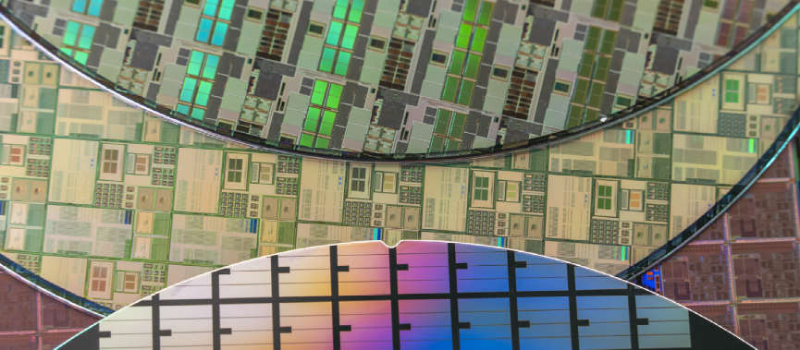
Role of ICP-MS in Minimizing Cross-Elemental Contamination from Reagents to Integrated Circuits (ICs)
The fabrication of smaller, denser, more power-efficient ICs with higher-performance characteristics requires ultra-high purity materials and reagents. To minimize cross-contamination of elemental impurities:
Dissolved elements are routinely monitored in process chemicals using ICP-MS
Single-particle (sp) ICP-MS methods are increasingly used to measure nanoparticles (NPs) in process chemicals
Silicon dioxide (SiO₂) NPs are potentially problematic to IC performance as they are insoluble in strong acids such as hydrochloric acid (HCl) or sulfuric acid (H₂SO₄) and organic solvents such as isopropyl alcohol (IPA).

Slide 3
Challenges of Analysis of SiO₂ NPs using spICP-MS
Providing a solution using the Agilent 8900 ICP-QQQ with MS/MS
Removal of intense interferences such as N₂ and CO on the major isotope of Si (²⁸Si).
Reduction of the Si background arising from the materials used within the ICP-MS instrument and utilities such as argon (Ar) gas or gas pipes.
Achieving the sensitivity needed for the measurement of Si.
  Si has a relatively high ionization potential (IP) meaning that fewer ions form in the plasma compared with many other elements, lowering its sensitivity.
MS/MS ensures excellent selectivity for Si through the elimination of the N₂ and CO interferences at mass 28 using hydrogen gas in the ORS⁴ cell.
A special gas flow system alleviates the Si background arising from the Ar gas supply.
The extremely high sensitivity and low background of the 8900 is key to the successful determination of SiO₂ NPs.

Slide 4
Automated Single Particle (sp)ICP-MS
Why use spICP-MS mode? Single particle ICP-MS simultaneously determines the number, concentration, and size of nanoparticles, as well as the dissolved element concentration of samples.
Dedicated software: The Single Nanoparticle Application Module of the Agilent ICP-MS MassHunter software enables Agilent ICP-MS and ICP-QQQ instruments to perform automated data analysis of NPs in spICP-MS mode.
Calculation of nebulization efficiency based on a particle standard: needed to convert the signals measured with spICP-MS to the particle content of the original sample.
Fast Time Resolved Analysis (TRA) capability: NPs produce a narrow signal peak for each particle that pass through the plasma. Peak intensity is proportional to the particle mass.
A successful spICP-MS analysis needs:

Slide 5
Samples and Sample Preparation
SiO₂ NPs were measured in ultrapure grade HCl, H₂SO₄, and IPA using the 8900 ICP-QQQ operating in spICP-MS mode.
The samples were prepared in precleaned PFA containers. 98% H₂SO₄ was diluted 100 times (100x) or 200x using ultrapure water (UPW), depending on the test and 36% HCl was diluted 5x in UPW. IPA was not diluted before analysis.
Standards containing 50, 60, and 100 nm SiO₂ NPs were bought from nanoComposix Inc (San Diego, CA USA).
The 100 nm SiO₂ NPs were used as a reference material for the calculation of the nebulization efficiency.
To evaluate the accuracy of the spICP-MS method for the determination of particle size, the 50, 60, and 100 nm SiO₂ NP standards were added to the diluted acids and undiluted IPA.

Slide 6
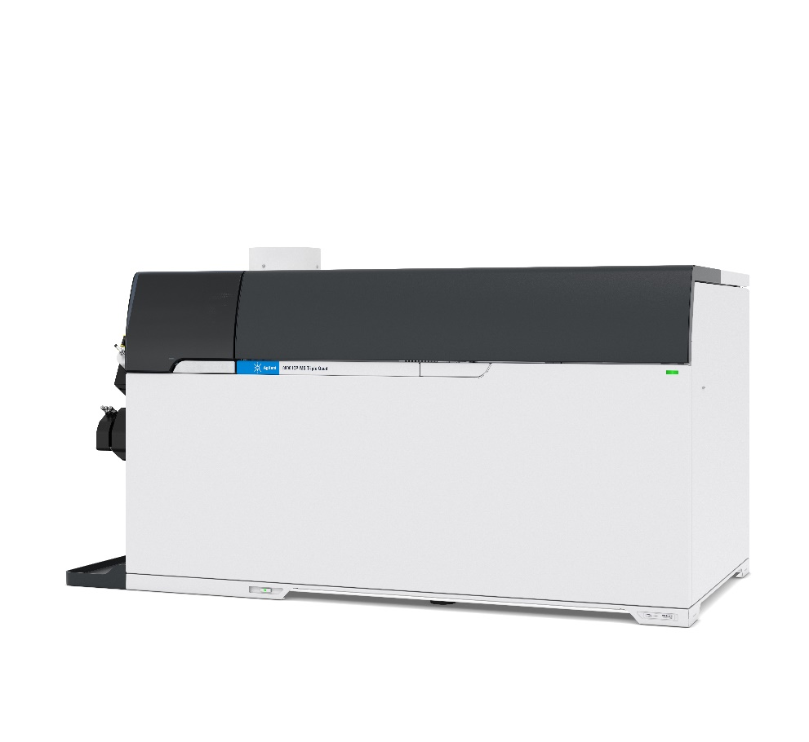
Instrumentation
Agilent 8900 ICP-QQQ
An Agilent 8900 ICP-QQQ (#200, Semiconductor configuration) and Agilent SPS 4 autosampler were used for all measurements. The samples were self-aspirated.
Sample introduction system:
Standard quartz torch (2.5 mm i.d. injector for acids, 1.5 mm i.d. injector for IPA).
Agilent PFA nebulizer
Quartz spray chamber
Standard platinum-tipped interface cones
Notes:
The 8900 ICP-QQQ was operated in MS/MS mode for all Si measurements and H2 cell gas was used to eliminate any polyatomic interferences on 28Si from 14N2 and 12C16O. 14N2 and 12C16O ions react readily with H2 in the cell, while Si ions do not react or react at a much slower rate.
Both quadrupoles (Q1 and Q2) were set to m/z 28, enabling 28Si+ to be measured free from the interferences at its original mass.
Analysis was performed in fast Time Resolved Analysis (fast TRA) mode using a dwell time of 0.1 ms.
Data analysis was performed using the optional Single Nanoparticle Application module of ICP-MS MassHunter software.

Slide 7
ICP-QQQ Operating Conditions
Parameter | Value
 | HCl, H₂SO₂ | IPA
RF Power (W) | 1200
Sampling Depth (mm) | 9 | 16
Nebulizer Gas Flow Rate (L/min) | 0.8 | 0.75
Makeup Gas Flow Rate (L/min) | 0.41 | 0.48
Option Gas (50% O₂/50% Ar) | NA | 12.0% (0.12 L/min)
Sample Uptake Rate (mL/min) | 0.22 | 0.27
Dwell Time (ms) | 0.1
Axial Acceleration (V) | 2
Energy discrimination (V) | –8.0
Acquired Mass Number | 28 for Q1 and Q2
Cell Gas | Hydrogen
Cell Gas Flow Rate (mL/min) | 5.0

Slide 8
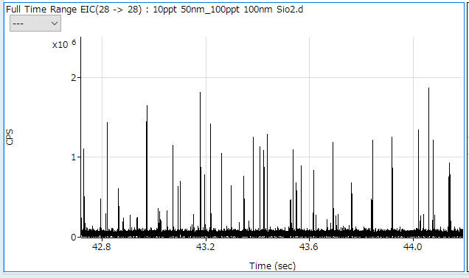
SiO₂ NP Analysis in Ultrapure Water
Typical signals from the mixed-sized SiO₂ NPs in UPW
50 and 100 nm SiO₂ signal NP events acquired in fast TRA mode using the Agilent 8900 ICP-QQQ.
Notes:
To assess the effectiveness of the 8900 spICP-QQQ method for the determination of SiO2 NPs, a mixture of approximately 10 ppt of 50 nm and 100 ppt of 100 nm SiO2 NPs were added to UPW. The Figure shows the typical signals from the mixed-sized SiO2 NPs in UPW. Smaller peaks (ranging from 1 x 105 to ~2 x 105 cps) from the 50 nm SiO2 NPs can be observed among the larger peaks (0.8 x 10⁶ to ~1.4 x 10⁶ cps) from the 100 nm SiO2 NPs.

Slide 9
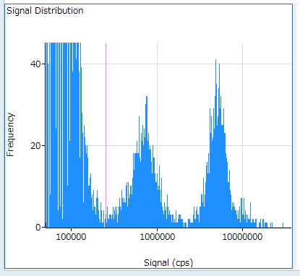
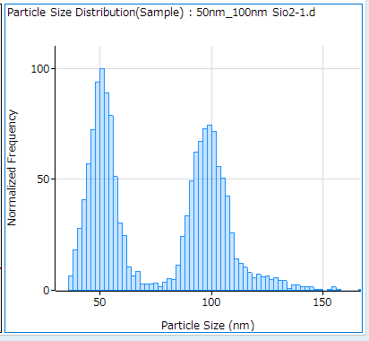
Signal and Size Distribution Results
50 and 100 nm SiO₂ NPs
100nm
50nm
Signal distribution (left) and size distribution (right) of 50 and 100 nm SiO₂ NPs in UPW.
Notes:
The Figure shows the signal and size distribution results from the 50 and 100 nm SiO2 NPs.
The size distribution plot shows good resolution between the 50 and 100 nm particles.
The mean sizes of the SiO2 NPs measured in UPW using the spICP-QQQ method were 50 and 99 nm, respectively.
The results confirm the viability of the method for the analysis of SiO2 NPs in more complex matrices.

Slide 10
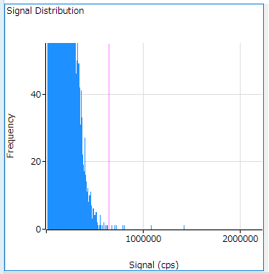
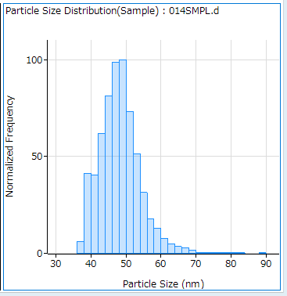
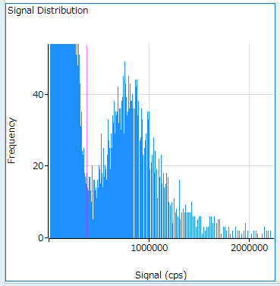
SiO₂ NP analysis in diluted HCl
Spike recovery test of 50 nm SiO₂ NPs in HCl
7.2% (x5) HCl blank
50nm SiO2 in 7.2% (x5) HCl
Distribution profiles of 50 nm SiO₂ in 7.2% HCl. Top left: signal distribution of HCl blank. Bottom left: signal distribution of 50 nm SiO₂ NPs added to HCl. Bottom right: particle size distribution of 50 nm SiO₂ NPs in HCl.
The excellent recovery confirms that 50 nm SiO₂ particles can be measured with good accuracy of NP size and concentration in HCl.
Notes:
To evaluate the performance of the 8900 spICP-QQQ method for the analysis of SiO2 NPs in high purity acids, 50 nm SiO2 NPs were added to 7.2% (5x diluted) HCl or 1% (100x diluted) H2SO4.
Per the signal distribution plot for the blank 7.2% HCl sample, no SiO2 particles were detected (Figure top left). When 20 ppt of 50 nm SiO2 NPs were added to the 7.2% HCl solution, clear signal distribution and particle distribution plots were obtained, as shown in the bottom left and right of the Fig, respectively. The red line in the Fig represents the threshold that separates single NP signals from the background or from ionic signals. The threshold is set automatically by the ICP-MS MassHunter software. The quantitative result for the SiO2 NPs measured in the 20 ppt spiked 7.2% HCl sample was automatically calculated by the Single Nanoparticle Application Module software as 22 ppt.

Slide 11
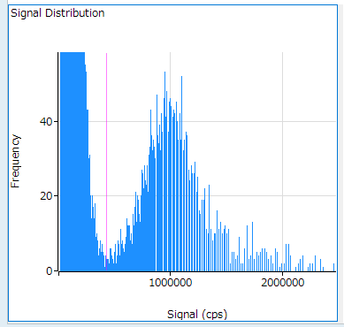
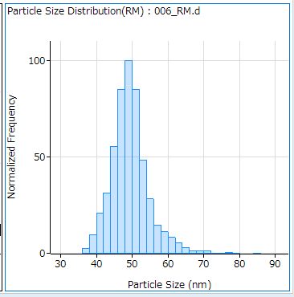
SiO₂ NP Analysis in Diluted H₂SO₄
Spike recovery test of 50 nm SiO₂ NPs in H₂SO₄
Signal distribution (left) and particle distribution (right) for 50 nm SiO₂ NPs in 1% H₂SO₄.
Despite the matrix, the signals from the 50 nm SiO₂ were clearly separated from the background signals.
Notes:
The Figure shows the signal distribution (left) and particle distribution (right) for 50 nm SiO2 NPs added to 1% H2SO4.

Slide 12
Long-Term Stability of SiO₂ NPs in H₂SO₄
Stability of 100 nm NPs over 10 hours
Long-term stability of particle concentration and particle mean size for 100 nm SiO₂ NPs in 200x diluted H₂SO₄.
Both the particle concentration and size were constant over the long run, demonstrating the stability of the spICP-QQQ method.
The stability test also confirms the insolubility of SiO₂ NPs even in 98% H₂SO₄. Any SiO₂ NPs present in reagents such as H₂SO₄ could affect the production yield and/or performance of semiconductor devices.
Notes:
To test the stability of measuring SiO2 NPs in H2SO4, 40 ppb of 100 nm SiO2 NPs were added to 98% H2SO4 (shown as 0 h on the stability plot). The solution was then diluted 200x with UPW at around 1-hour intervals before measurement using the 8900 spICP-QQQ method. The Figure shows the stability of particle concentration and particle mean size for the 100 nm SiO2 NPs in 200x H2SO4 over 10 hours.

Slide 13
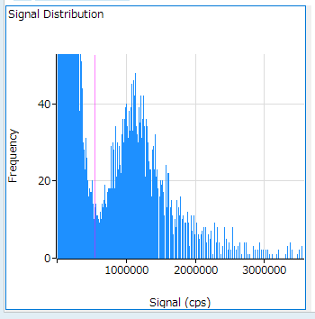
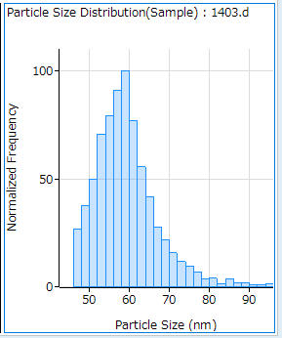
SiO₂ NP analysis in IPA
Spike recovery of 50 ppt of 60 nm SiO₂ NPs
The measurement of SiO₂ NPs in organic solvents by spICP-MS is challenging due to the formation of a ¹²C¹⁶O ion interference on ²⁸Si arising from the carbon matrix.
The effectiveness of the spICP-QQQ method using MS/MS mode and H₂ cell gas to eliminate the CO interference on Si was tested by spiking undiluted IPA with 50 ppt of 60 nm SiO₂ NPs.
Signal distribution (left) and particle size distribution (right) of the 60 nm SiO₂ NPs in IPA.
The 60 nm SiO₂ NPs were detectable in undiluted IPA using the spICP-QQQ method due to the high sensitivity and effective interference removal performance of the 8900 ICP-QQQ.

Slide 14
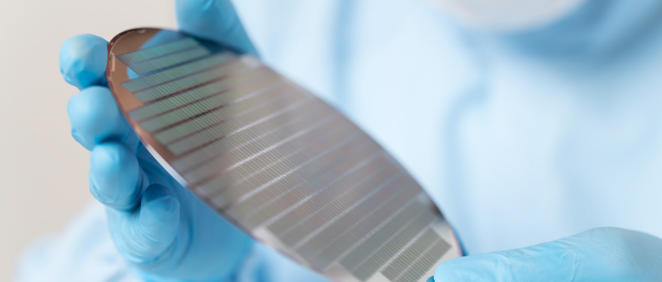
Successful Analysis of NPs in Semicon Reagents
Keys to success of determination of SiO₂ NPs
The application is expected to become an increasingly important QC procedure for reagents used in the fabrication of high-performance devices.
The Agilent 8900 ICP-QQQ operating in spICP-MS mode provides:
Effective interference removal performance: Using H₂ in the ORS⁴ cell, MS/MS eliminated N₂⁺ and CO⁺ interferences on Si at m/z 28.
High sensitivity: Enabled the detection of peaks from 50 or 60 nm particles above the background in all three ultrapure grade reagents.
Dedicated Single Nanoparticle Application Module for ICP-MS MassHunter software: Used to calculate the particle sizes and concentration.
The method provided good recoveries for the measurement of spiked NP samples during different tests.

Slide 15
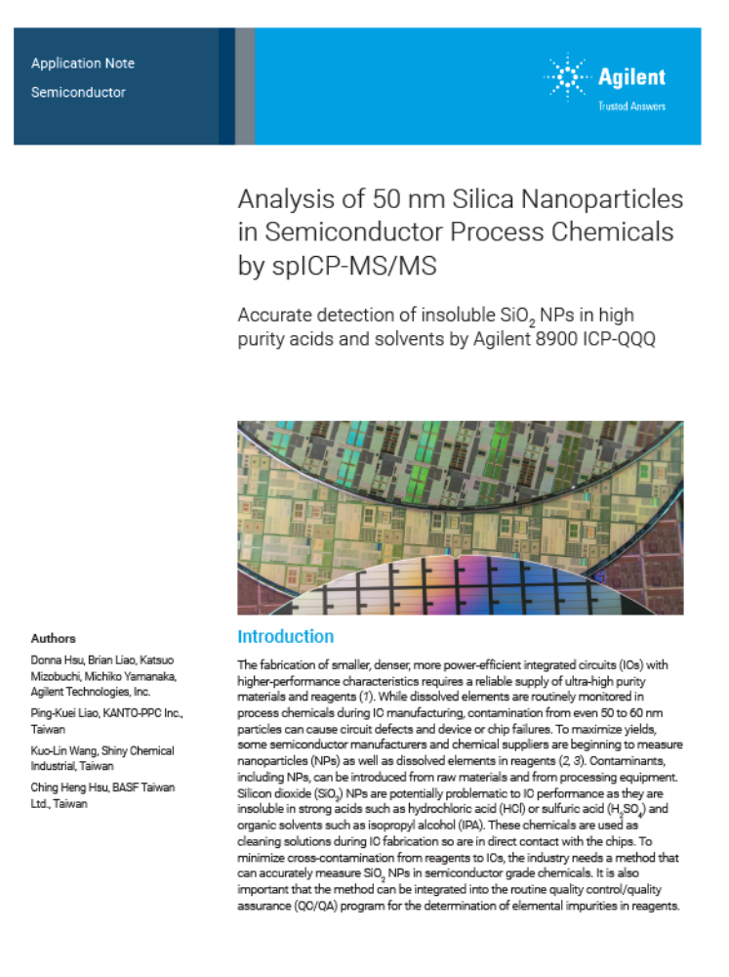
ICP-MS Application Note
5994-5866EN
Authors
Donna Hsu, Brian Liao, Katsuo Mizobuchi, Michiko Yamanaka, Agilent Technologies, Inc.
Ping-Kuei Liao, KANTO-PPC Inc., Taiwan
Kuo-Lin Wang, Shiny Chemical Industrial, Taiwan
Ching Heng Hsu, BASF Taiwan Ltd., Taiwan
Publication number: 5994-5866EN
Link: Analysis of Small-Sized SiO2 Nanoparticles in Chemicals used in Semiconductor Manufacturing by spICP-MS (agilent.com)

